Slide 1




Stance Detection from Text
Group no.: 8
Members:
Mentor: Dr. Irfan A Siddavatam
1814040 | Nishavak Naik
1814033 | Atharva Kitkaru
1814108 | Krisha Mehta

Slide 2
Roadmap
Introduction
Problem definition
Background work
Functional and non-functional requirements
Literature survey
Technologies used
Implementation details
Results
Conclusion
Future work
References
Notes:
#ee4026 light red
#b7312e dark red

Slide 3
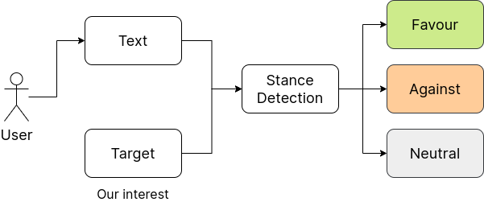
Stance Detection
Stance is defined as the expression of the speaker’s standpoint and judgement toward a given proposition.
Stance detection is the task of automatically determining from text whether the author of the text is in favor of, against, or neutral towards a proposition​.
Working of Stance detection

Slide 4
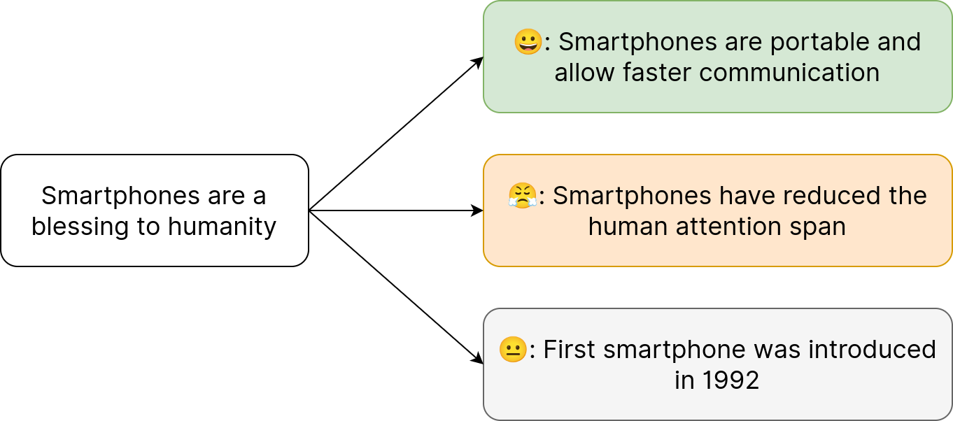
Example
Target
Text
Example of Stance detection

Slide 5
Problem Definition
Introduction of social media platforms has allowed people to express their opinions freely on variety of topics. Some topics tend to be controversial and garners a spectrum of opinions. ​
Understanding the stance of people on these topics and messages becomes crucial to understand the general opinion of public which can be used for further studies and analysis.​
Our project aims at implementing a platform that allows for the detection of stance from text. ​
To implement this, we will be using stance detection models which take the input, preprocess it in the format suitable, extract the relevant features and deliver the predictions. ​
Furthermore, we will be comparing the results of different models to find the best performing one. Along with that, we will be providing a user interface so that users can interact with the trained models for detection of stance.

Slide 6
Comparison with other NLP Tasks
Stance Detection | Sentiment Analysis | Opinion Mining
Automatically determine from text whether the author of the text is in favor, against, or neutral towards a target. | Extract user’s sentiment. | Extract subjective information from text data using tools such as NLP, text analysis and computational linguistics.​
It is focused towards a particular target​. | It gives generalized sentiment of the whole sentence instead of targeted sentiment​. | It extracts opinions of the user instead of analyzing the sentiment.
Stance Detection Vs Other NLP tasks

Slide 7
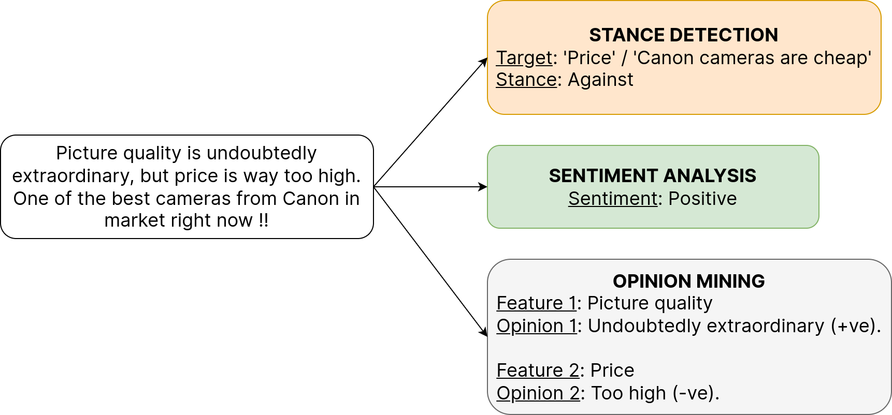
Example
Example of Stance Detection vs Sentiment Analysis Vs Opinion Mining

Slide 8
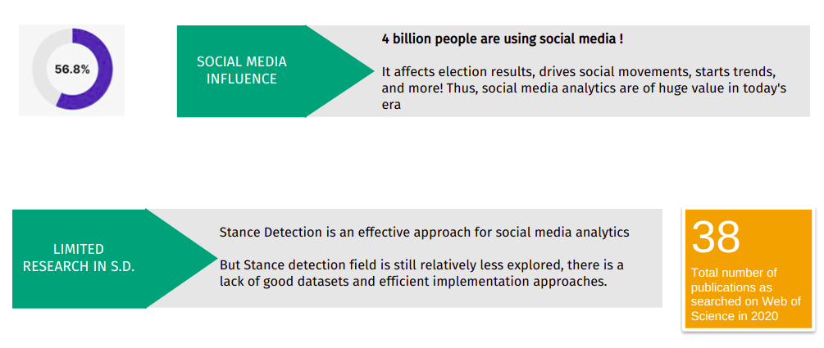
Need
Percentage of Social Media users as per kepios analysis [5]

Slide 9
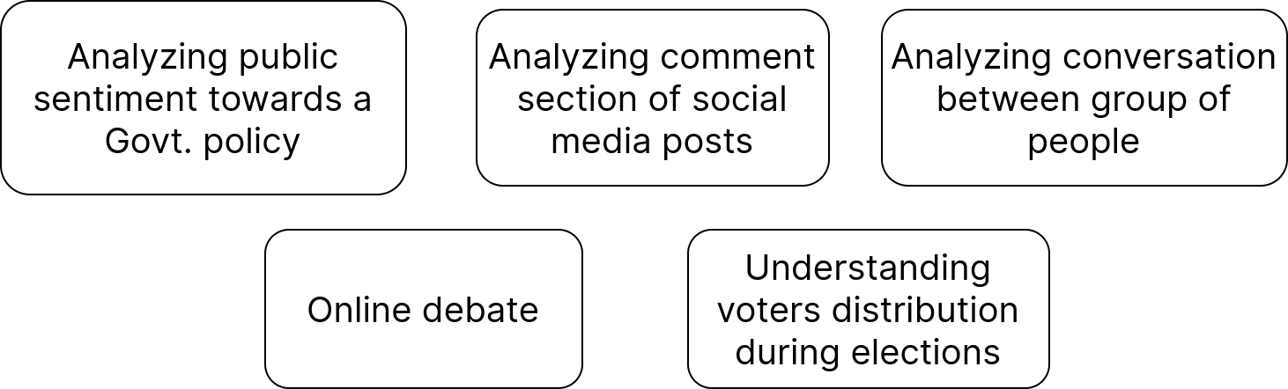
Practical Uses of Stance Detection

Slide 10
Functional and Non-functional requirements
Functional requirements
The system should be able to preprocess the text data and should be able to deal with symbols too.
The system should be able to detect the stance of the inputs (target and reply) provided and classify it into one of the following: ‘favor’, ‘against’, or ‘neutral’.
The System will provide a graphical user-friendly interface for a better understanding of results.
It should be able to generate performance results with appropriate metrics.
It should be able to compare results generated by different algorithms.
Non-functional requirements
Usability, Availability, Maintainability, Reliability

Slide 11
Literature Review of Key Papers
Paper | Author Details | Publication Details | Approach | Limitations / Future Scope
Zero-Shot Stance Detection: A Dataset and Model using Generalized Topic Representations​[1] | Emily Allaway (Columbia University) , Kathleen McKeown Columbia University | 2020 | The model consists of a contextual conditional encoding layer followed by topic-grouped attention using generalized topic representations (GTR) and a feed-forward neural network. | Investigation of additional methods to represent and use generalized topic information, such as topic modeling.
Stance Detection with bi-directional conditional encoding​[2] | Isabelle Augenstein and Tim Rocktäschel ¨ (University College London), Andreas Vlachos and Kalina Bontcheva (University of Sheffield) | 2016 | This paper experimented with the conditional LSTM encoding, which builds a representation of the tweet that is dependent on the target,and then further augmented the model with bidirectional encoding Dataset used is SemEval 2016 Twitter Stance Detection corpus. | Investigating further the challenge of stance detection for tweets which do not contain explicit mentions of the target

Slide 12
Literature Review of Key Papers
Paper | Author Details | Publication Details | Approach | Limitations / Future Scope
BERT: Pre-training of Deep Bidirectional Transformers[3] | J. Devlin, M.-W. Chang, K. Lee, en K. Toutanova | 2018 | BERT is designed to pre-train deep bidirectional representations from the unlabelled text by jointly conditioning on both left and right context in all layers. The pre-trained BERT model can be fine-tuned with just one additional output layer to create state-of-the-art models without substantial task-specific architecture modifications.​ | High computing resources to train the models. Small BERT introduced to address the issue but not perfect yet.
BiLSTM-Autoencoder Architecture for Stance Prediction​[4] | S. M. Padnekar, G. S. Kumar and P. Deepak | 2020, International Conference on Data Science and Engineering (ICDSE) | This paper discusses a stance prediction technique to determine the authenticity of news articles. The task input is the news articles’ headline & body. It proposes a deep learning architecture using Bi-directional LSTM and Autoencoder for stance prediction. | Difficulty in capturing the natural languages’ complexities by ML algorithms. Single factor like source credibility or writing style, cannot effectively detect fake news articles.

Slide 13
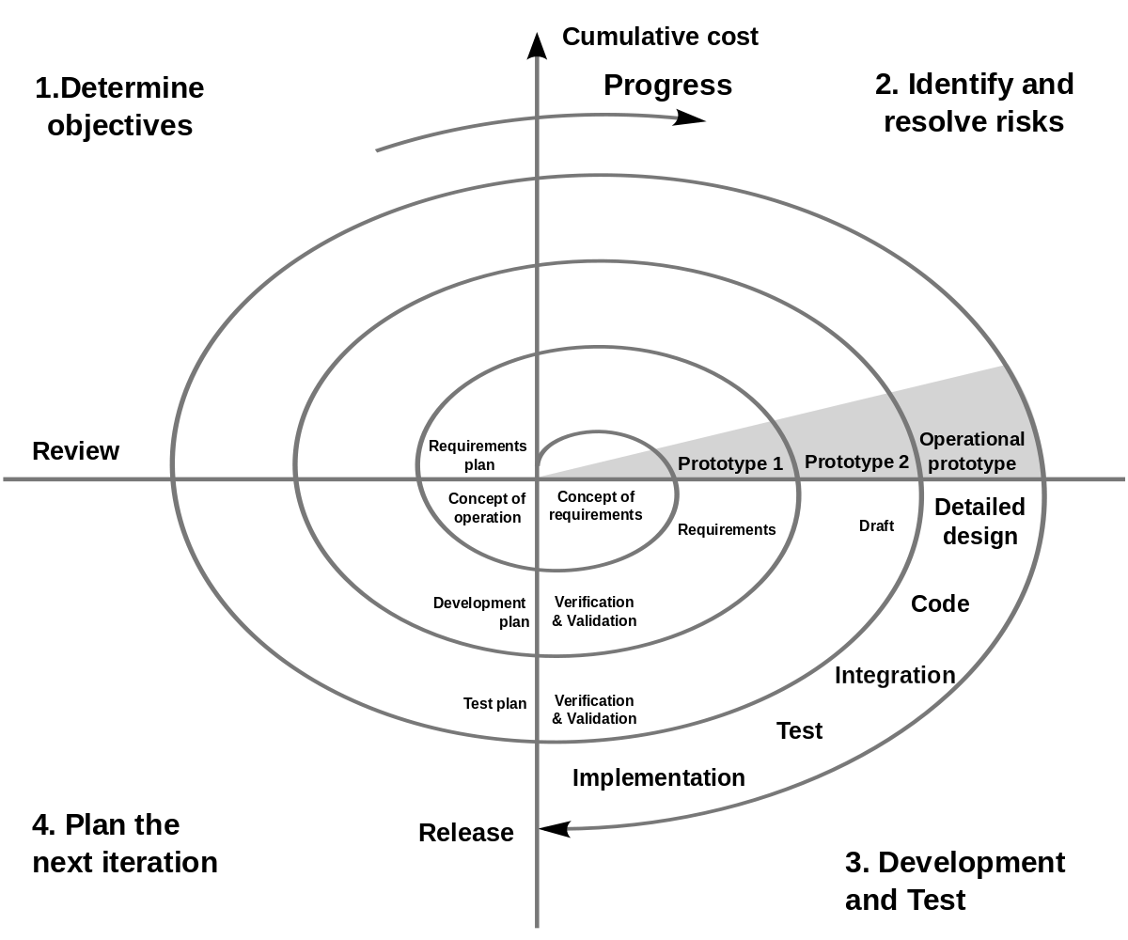
Technologies used
Process model
Frontend
React.js
Bootstrap
Sass
Backend
Django
ML model development
Google colaboratory
Gensim - Word2Vec
Transformers - sBERT
Scikit learn
TensorFlow
Version control
Git
Github
Spiral model

Slide 14
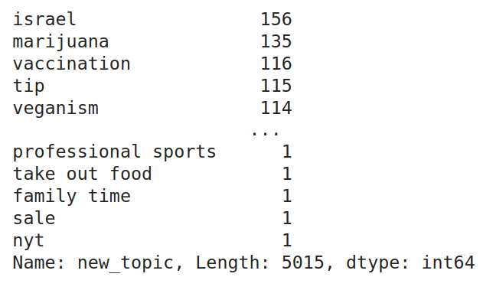
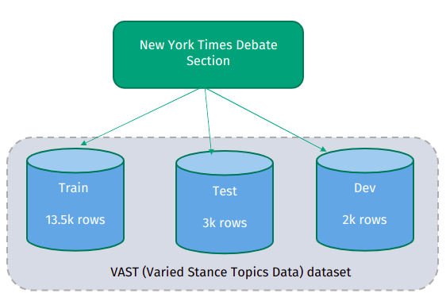

Dataset
List of training topics
VAST dataset, procured from [1]
Drawbacks of VAST dataset
WordCloud of Training Topics

Slide 15
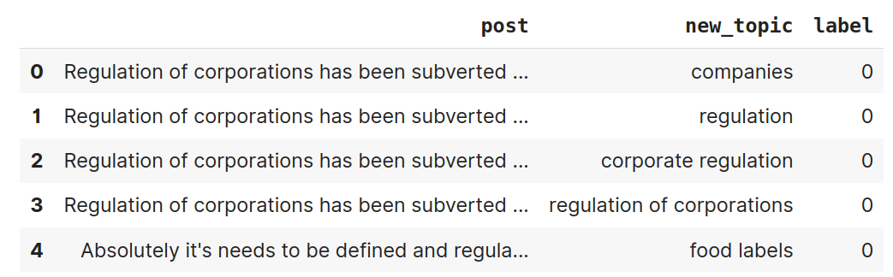
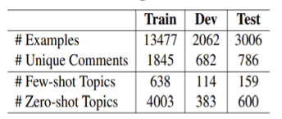
*Dataset
First 5 rows of VAST dataset
Zero Shot: Completely new topics which have not been seen by classifier​.
Few Shot: Topics for which it has very few training examples​.
Number of zero shot and few shot topics for train, test and dev set

Slide 16
Problems with the existing popular stance datasets
Not explicitly labeled for topics (Eg: Debatepedia)
Very small number of topics (Internet Argument Corpus 2.0, Semeval 2016)
No linguistic variation in the topic expressions (WillTheyWon’tThey, Semeval 2016)
No clear pro/con labels (Eg: Debatepedia)
Only handful of unseen topics / zero-shot topic (Semeval-2016, one of the most popular datasets, only 1 zero shot topic)

Slide 17

Implementation approach

Slide 18
Model training
Implementation
Embedding
Target Generalization
Classifiers
Contextual
Context-Free
BERTopic
Scikit Learn
TensorFlow
Sentence Transformers
Word2Vec
Agglomerative
Gradient Boosting
Dense
None
K-Nearest Neighbor
LSTM
Gaussian Naive Bayes
Bi-LSTM
Support Vector Machine
We trained
(2 Embedding) * (3 Target Generalization) * (10 Classifiers) = 60 models
Logistic Regression
Decision Tree
Random Forest

Slide 19
Results
Stance Label | Best Performing Model | F1-score
Against | Context-free Bertopic gradient boosting classifier | 0.51
Pro | Context-free no grouping gradient boosting classifier | 0.6
Neutral | Context-free no grouping gradient boosting classifier | 0.89
Overall | Context-free no grouping gradient boosting classifier | 0.62 (Accuracy)
F1 scores help to better understand the individual label classification. Accuracy, on the other hand, helps understand overall performance.
All Results

Slide 20
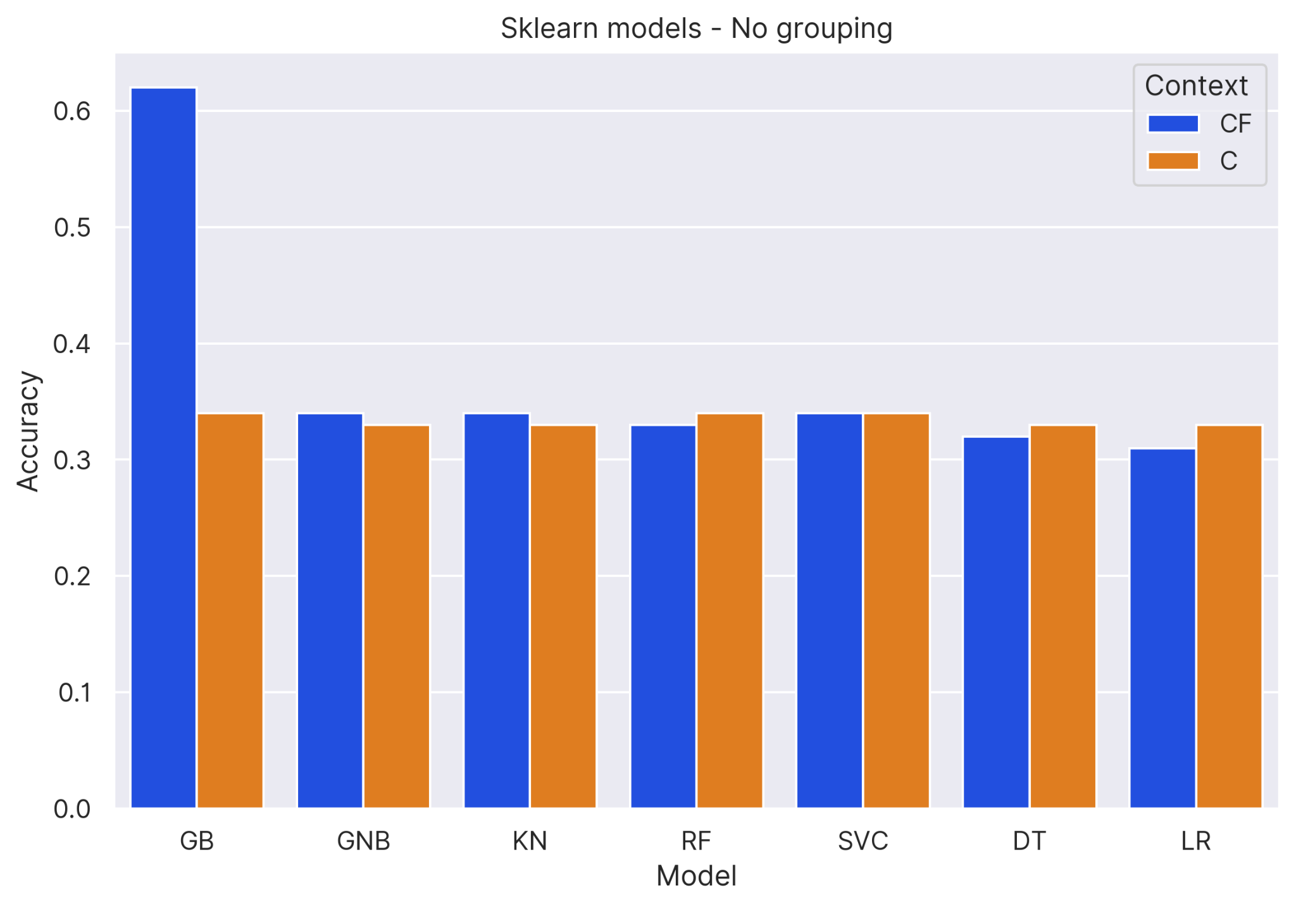
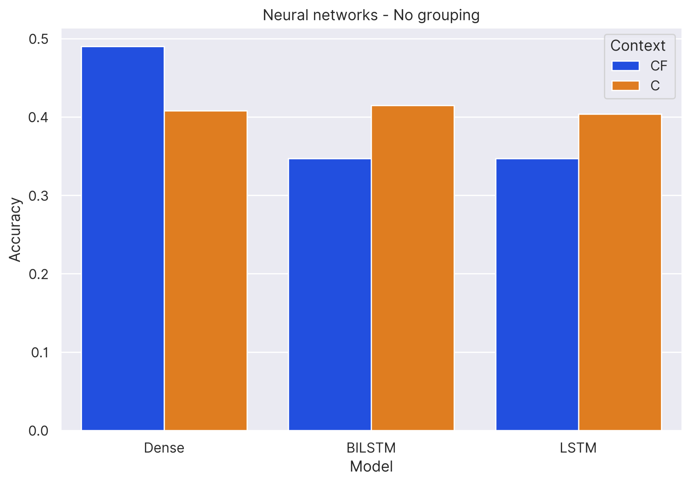
Results
Context-free vs Contextual: No target generalization
Comparison of sklearn models showed that results were almost similar for context-free and contextual (except GB)
Comparison of neural network models showed that contextual gave slightly better results compared to context-free (except Dense model)

Slide 21
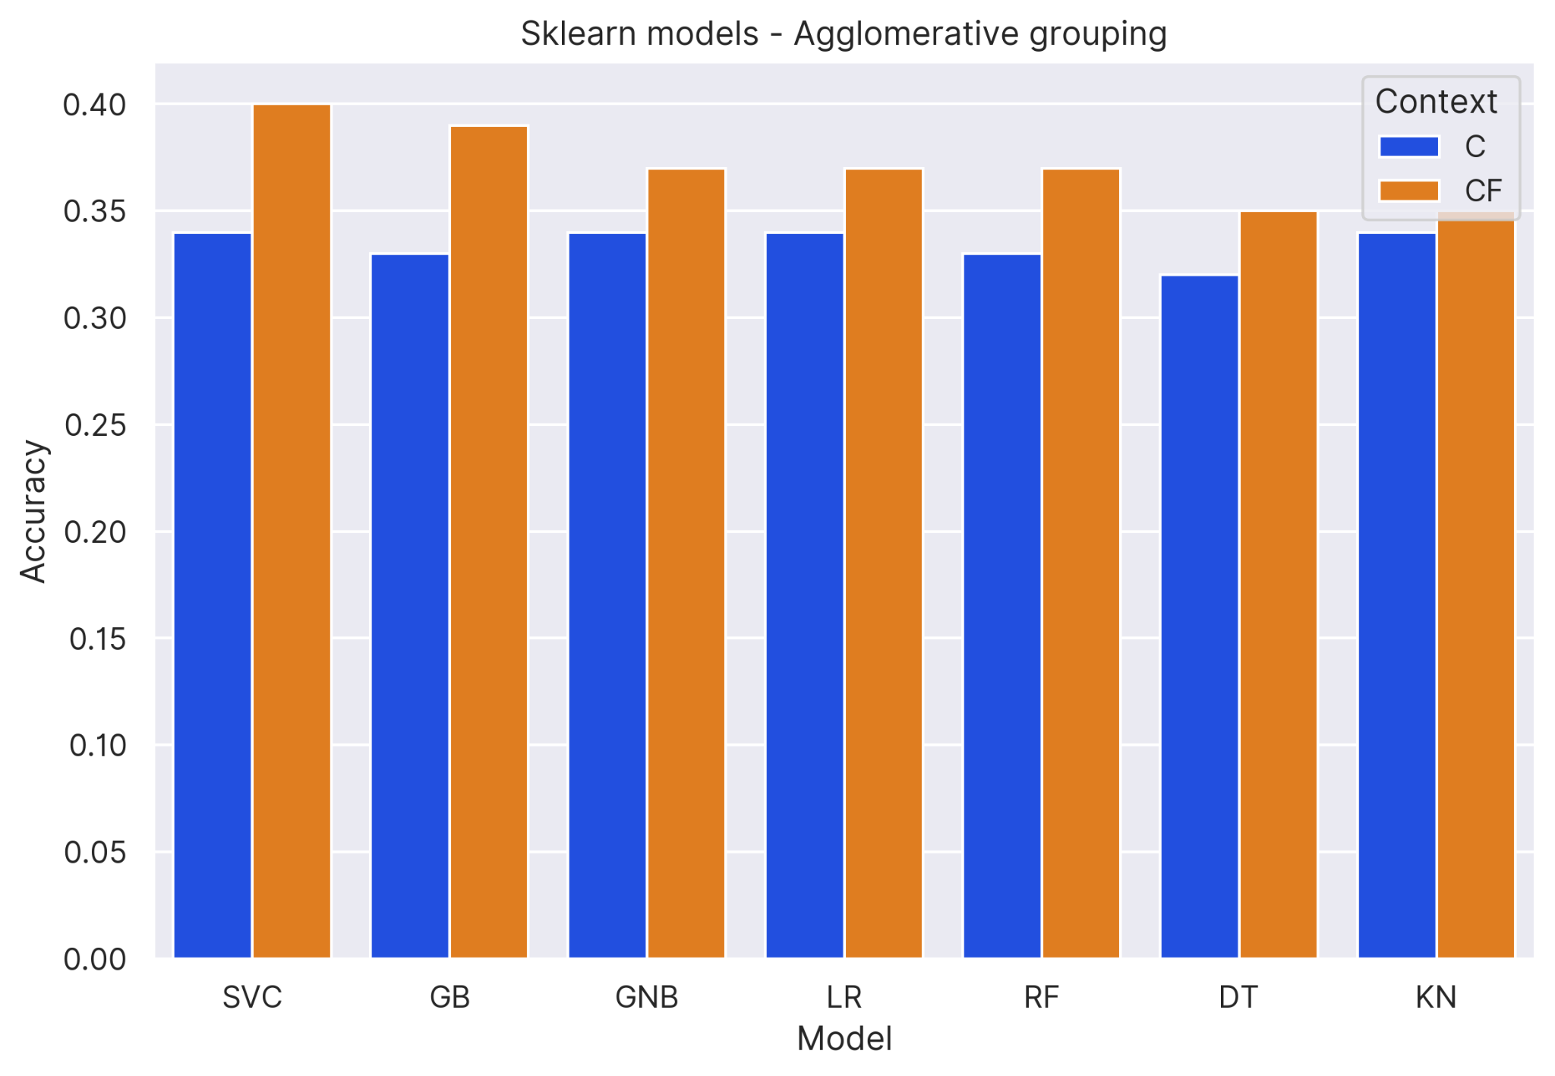
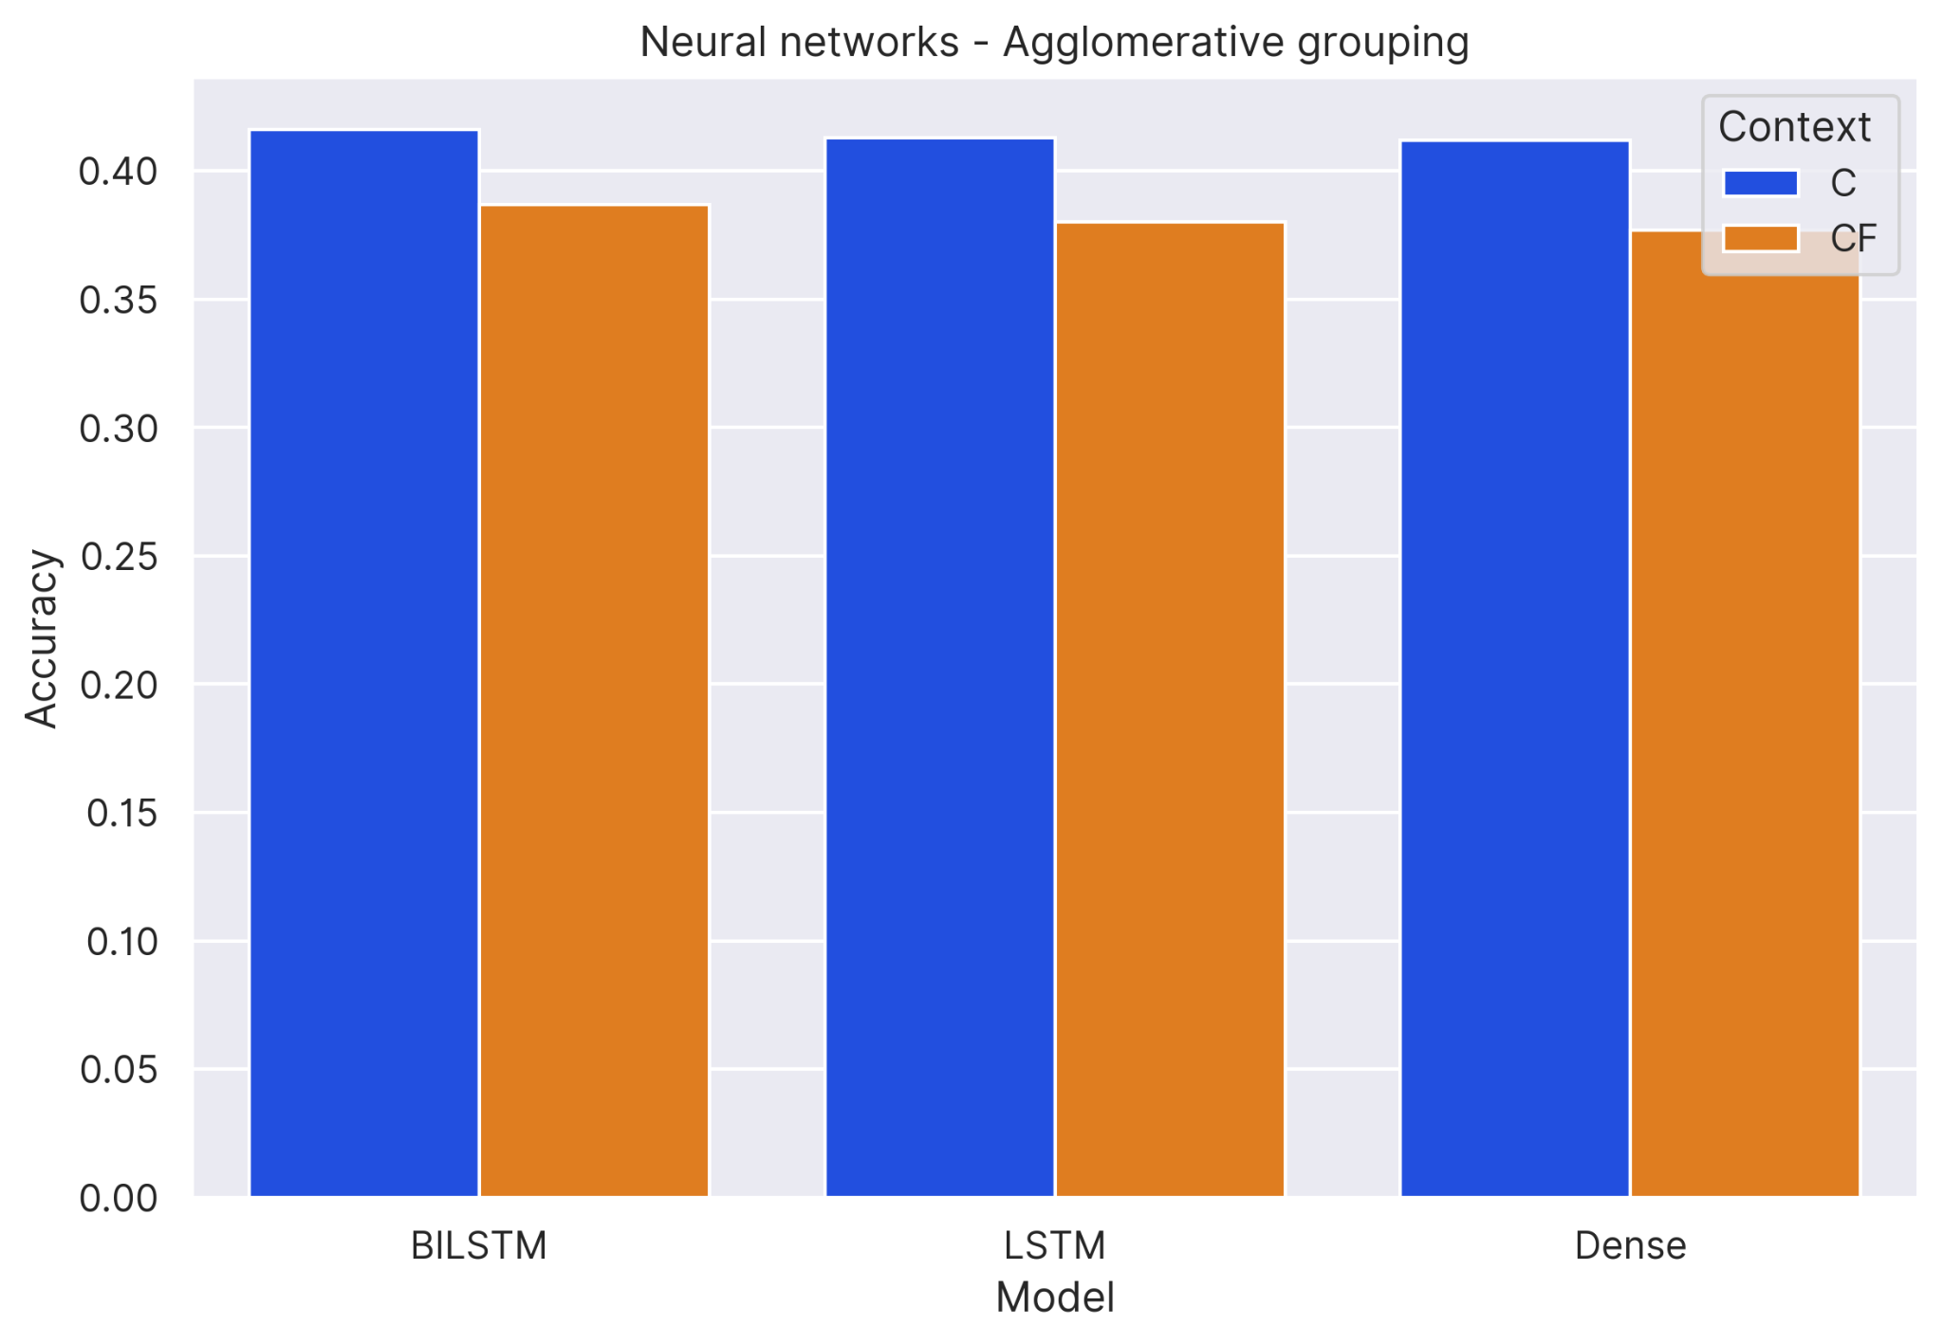
Results
Context-free vs Contextual: Agglomerative Clustering
Comparison of sklearn models showed that context-free performed slightly better than contextual
Comparison of neural network models showed that contextual performed slightly better than context-free

Slide 22
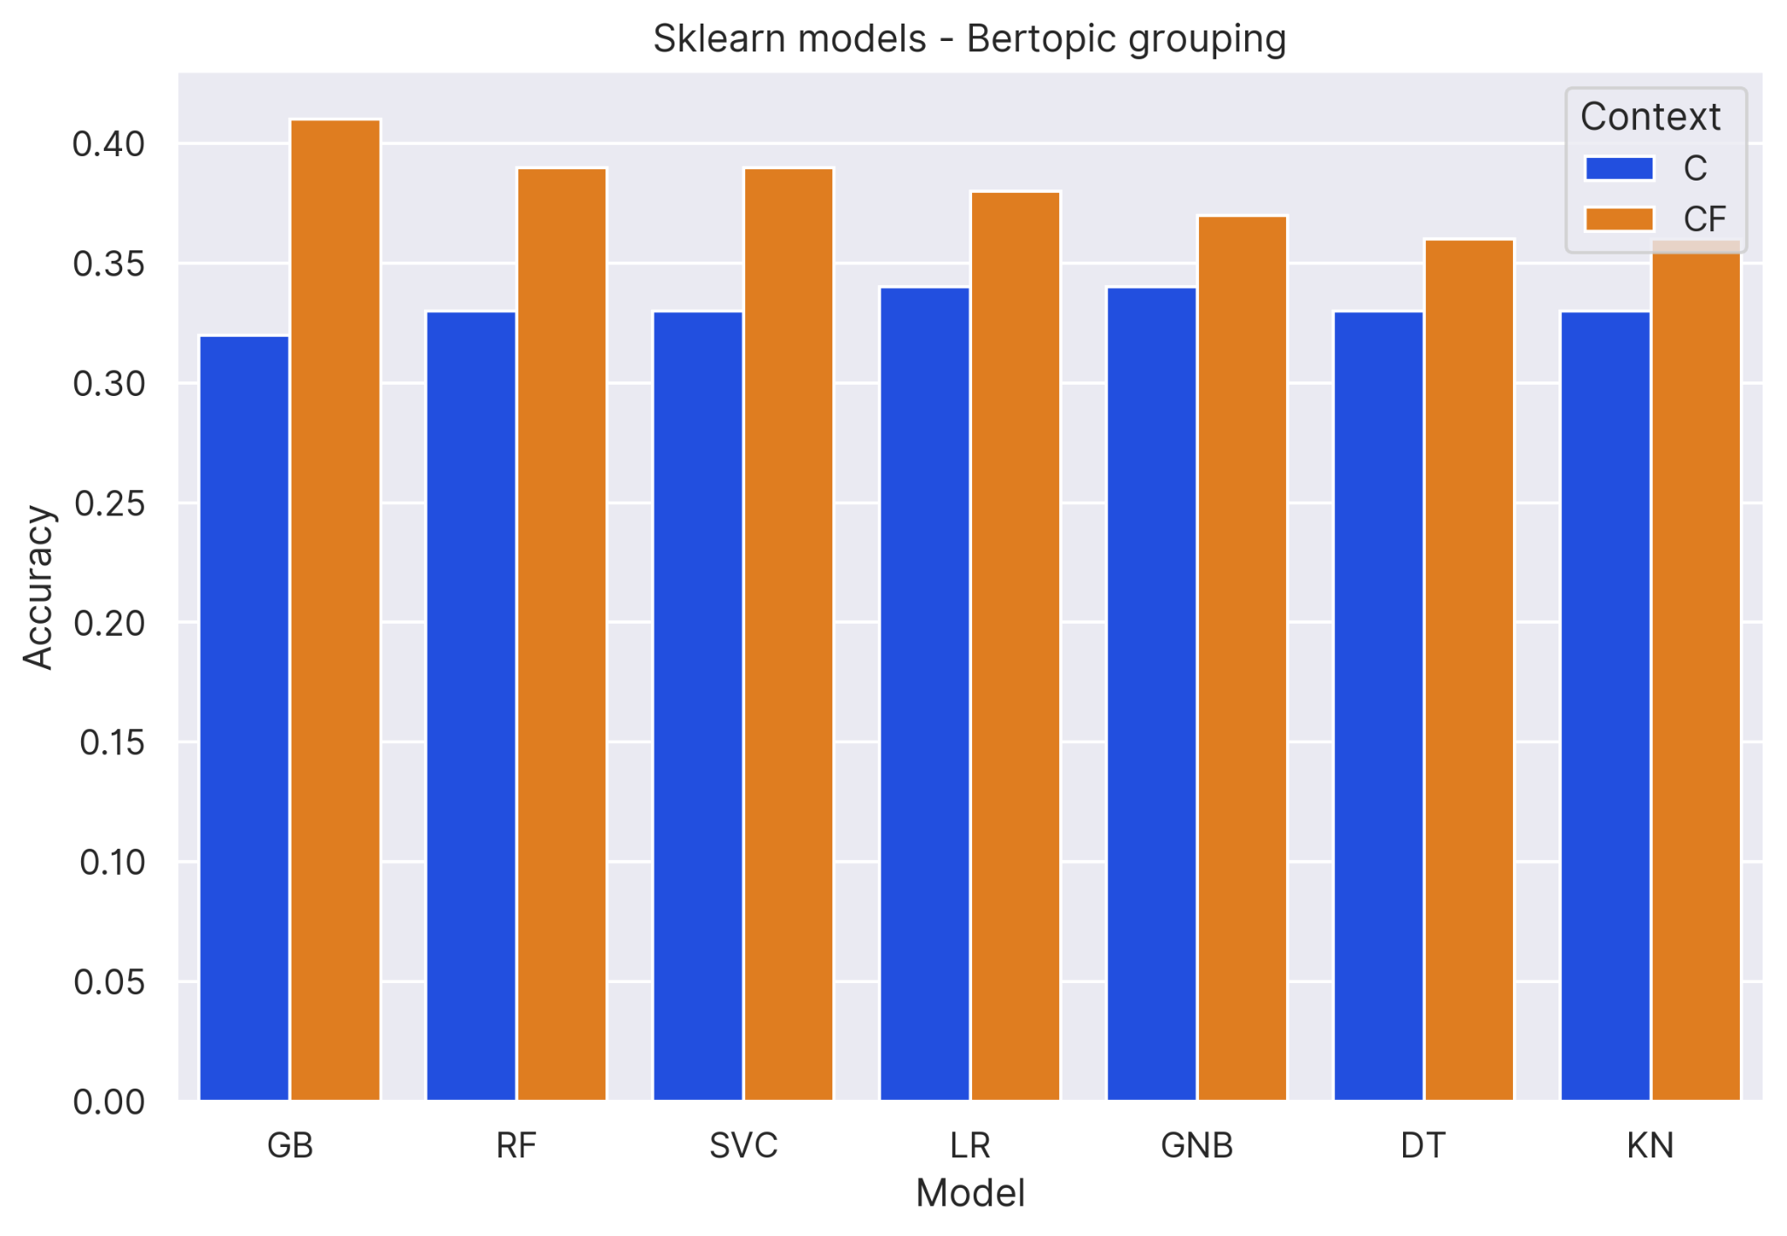
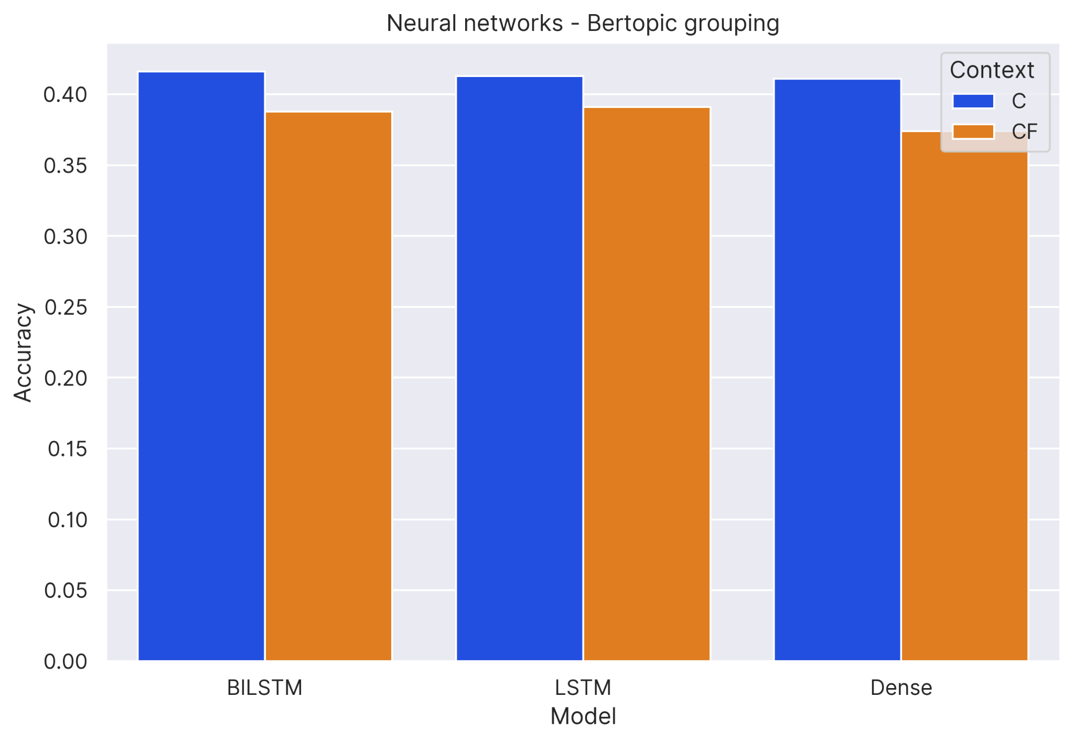
Results
Context-free vs Contextual: BERTopic
Comparison of sklearn models showed that context-free outperformed contextual
Comparison of neural models showed that contextual outperformed context-free

Slide 23
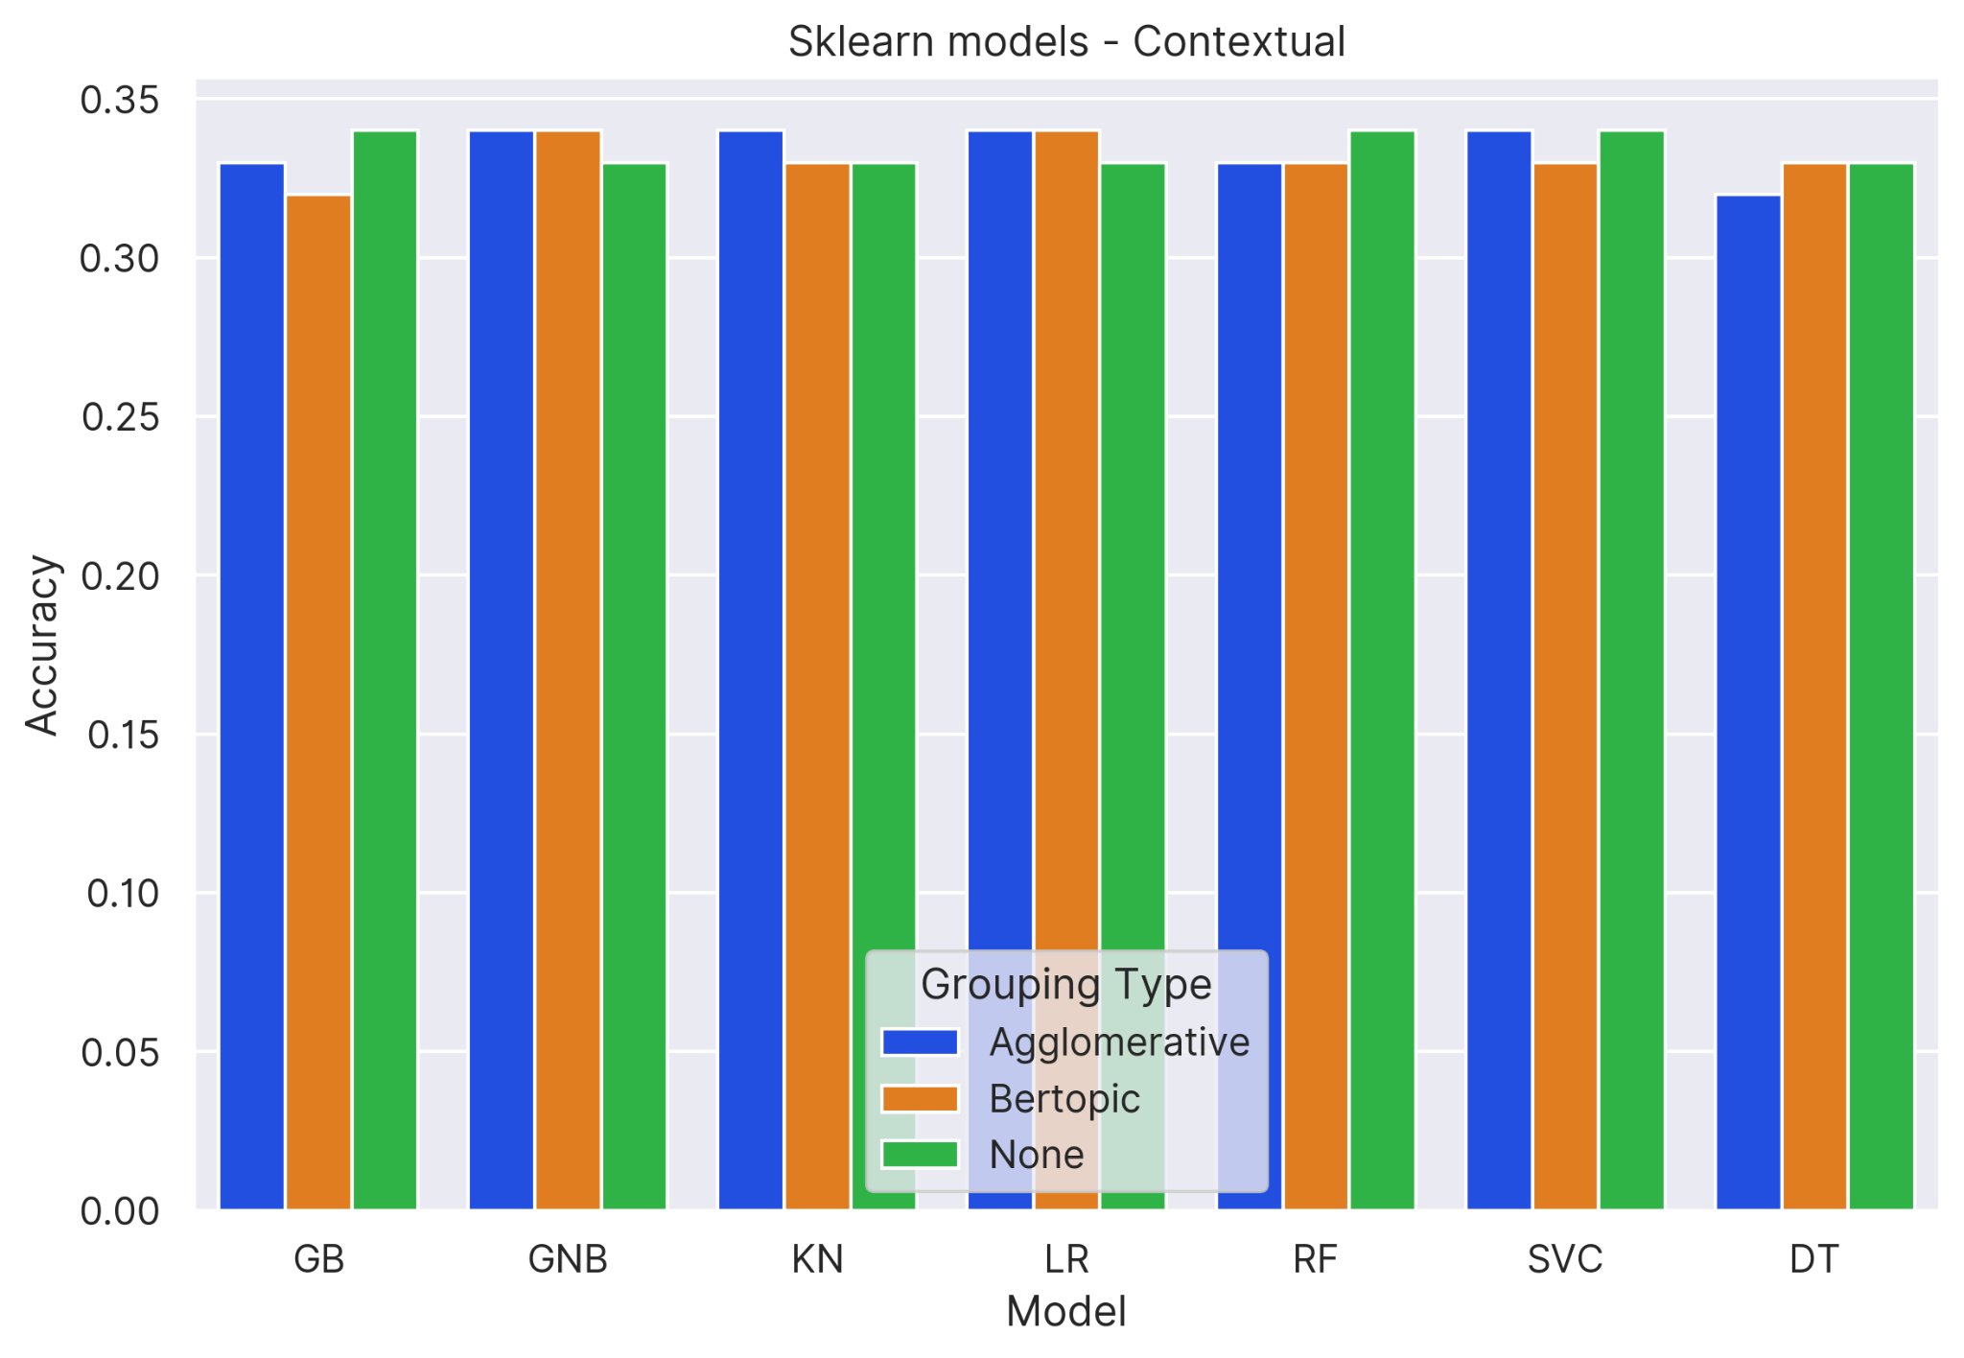
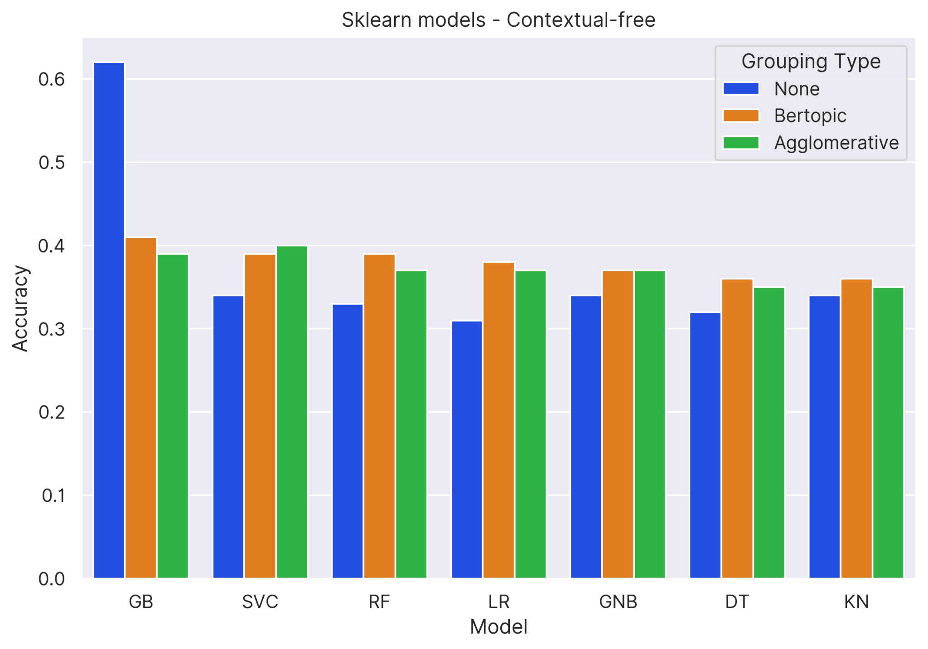
Results
Comparison by generalization type: Sklearn models
Comparison of different grouping types for sklearn contextual models shows mixed results
Comparison of different grouping types for sklearn context-free models shows performing grouping gave better results than no grouping (except GB)

Slide 24
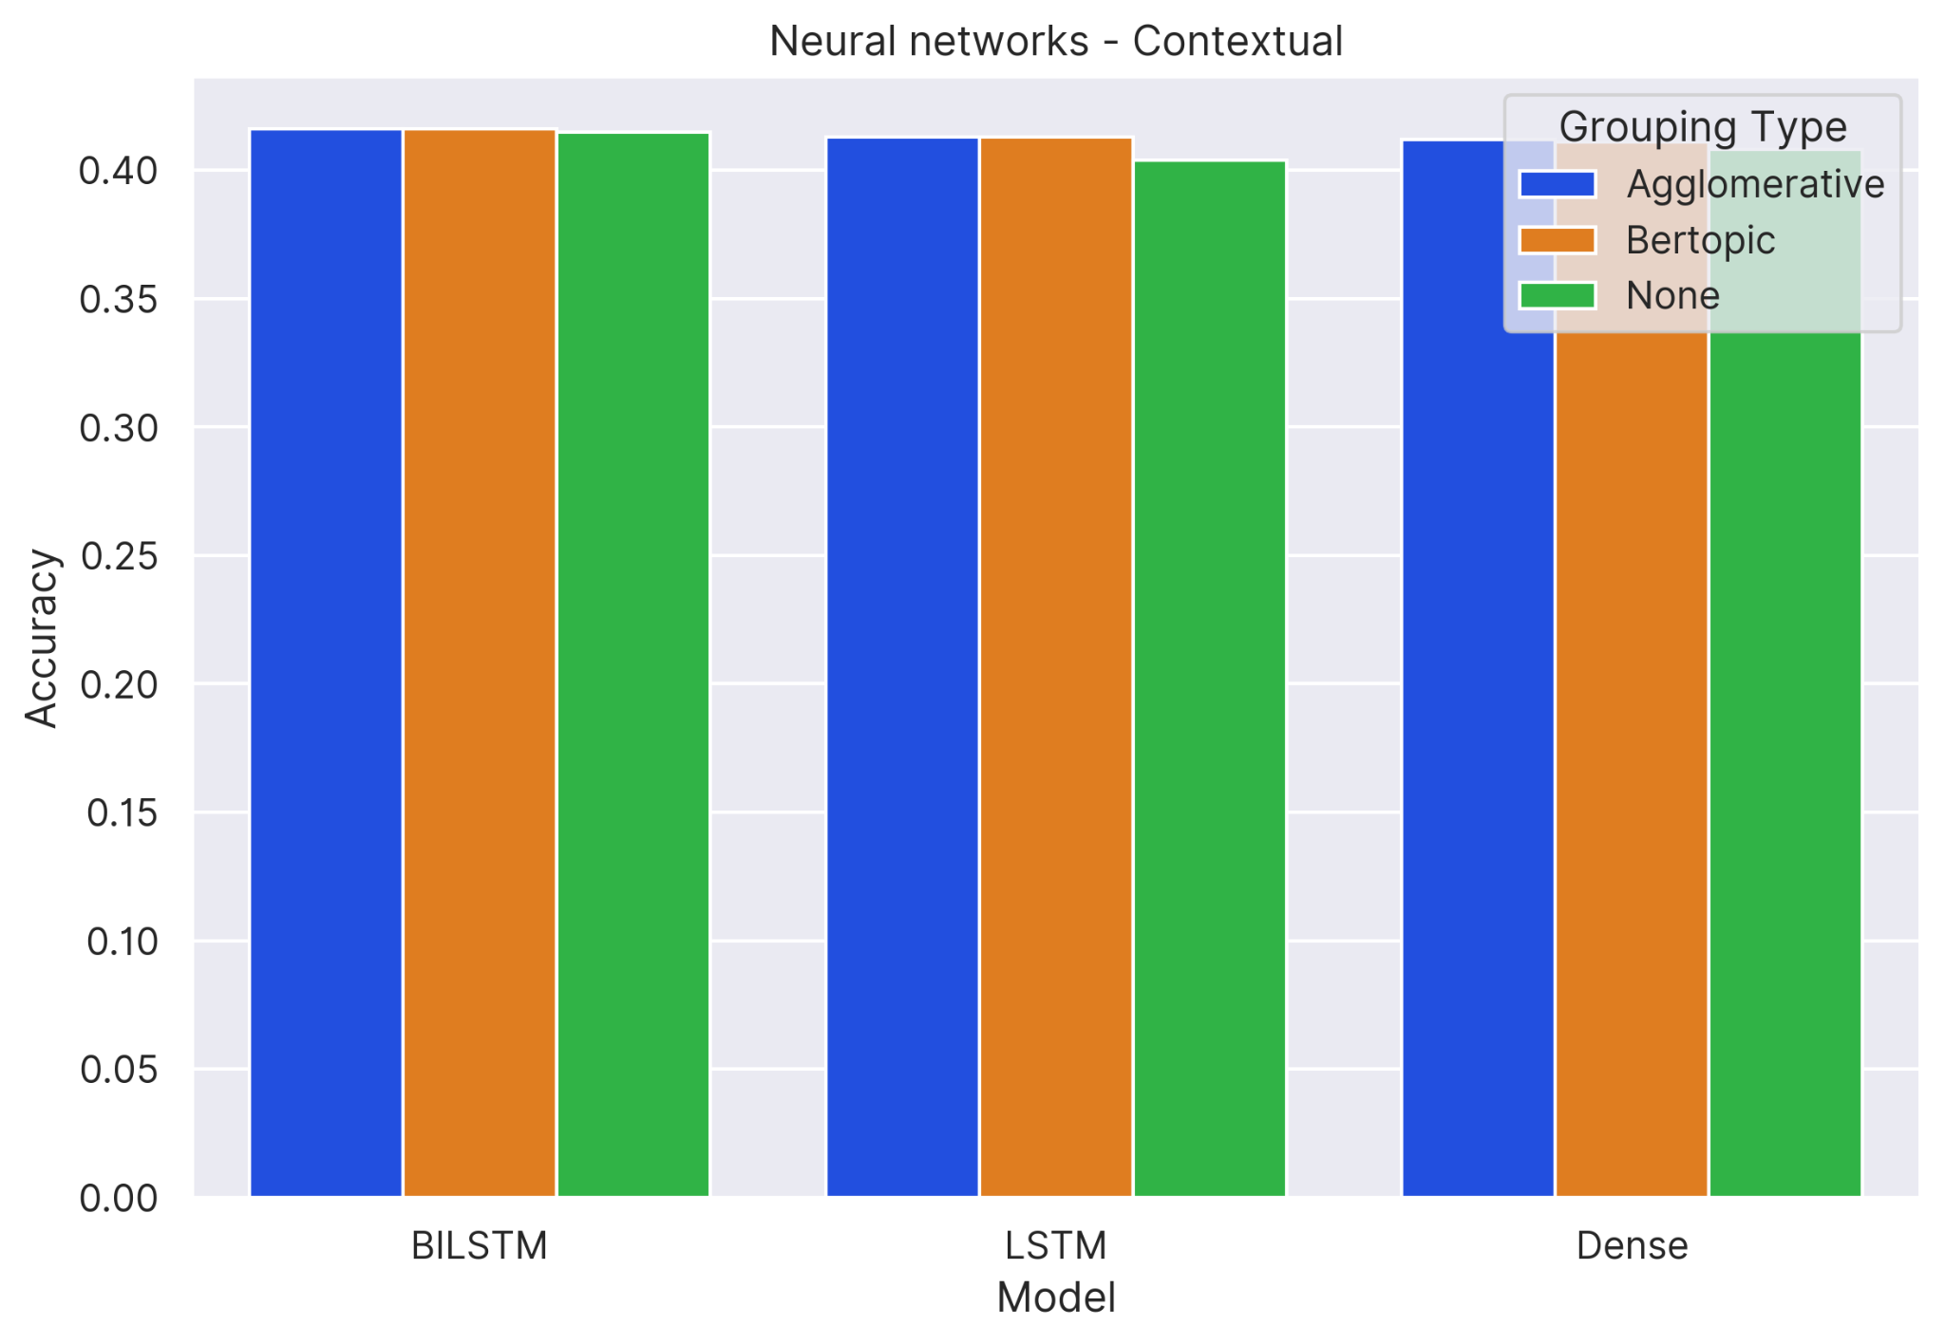
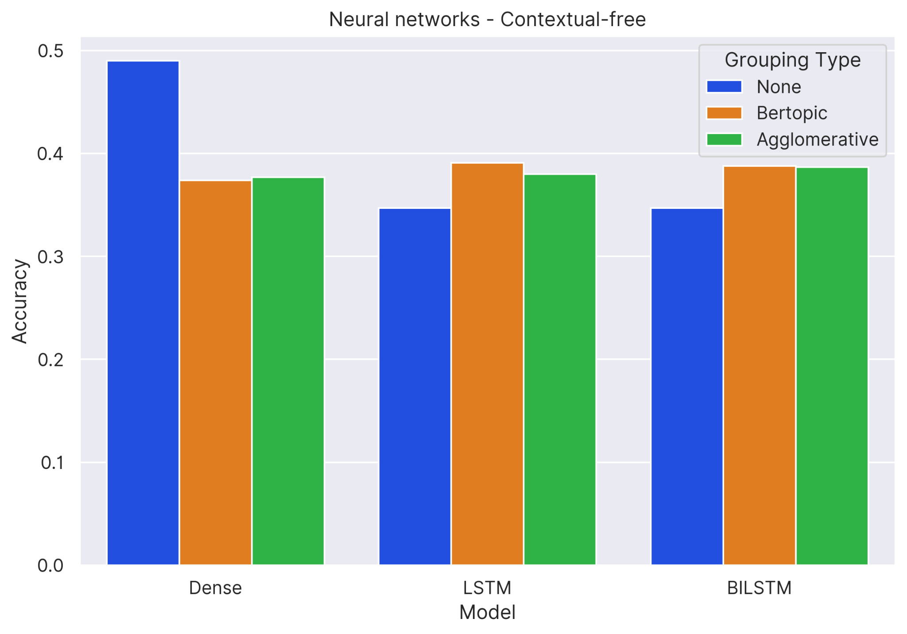
Results
Comparison by generalization type: Neural networks
Comparison of grouping type for NN contextual models shows the effect of grouping to be almost negligible
Comparison of grouping type for NN context-free models shows that grouping gave better results than no grouping (except Dense)

Slide 25
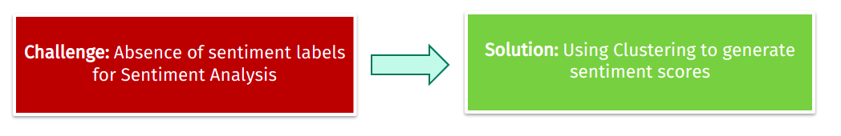
Dataset usefulness
Did we use the dataset for the right NLP task?
One way to verify: Try sentiment analysis on the same dataset​

Slide 26
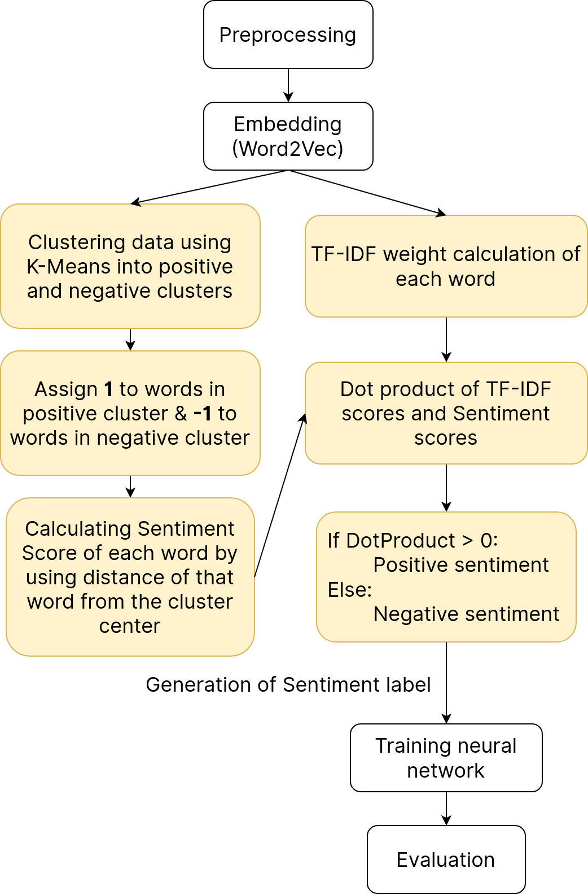
Sentiment Analysis

Slide 27
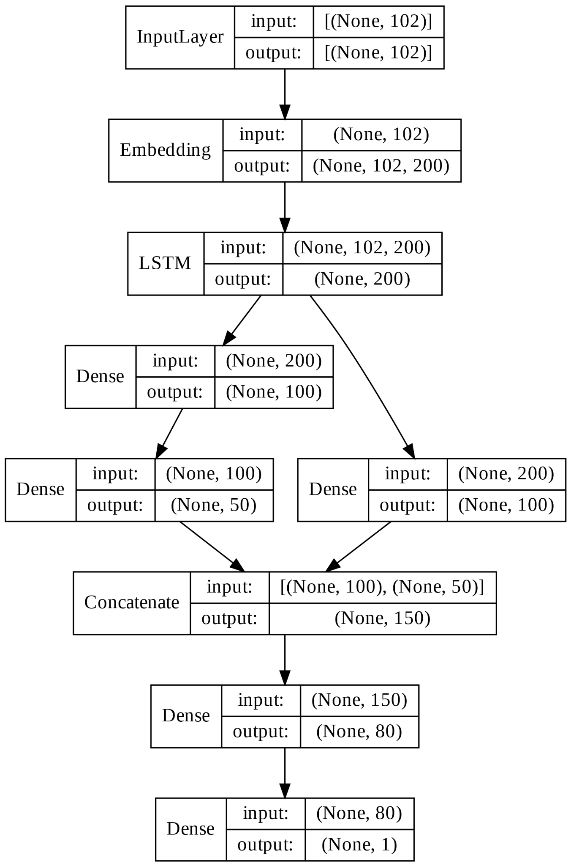
Sentiment Analysis Neural Network Model Design

Slide 28
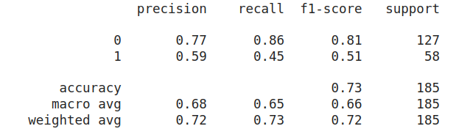
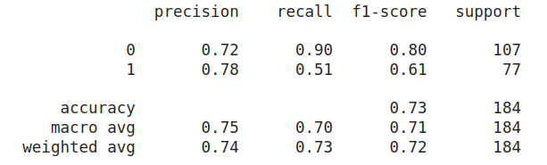
Sentiment Analysis Results
Test Set Results
Validation Set Results

Slide 29
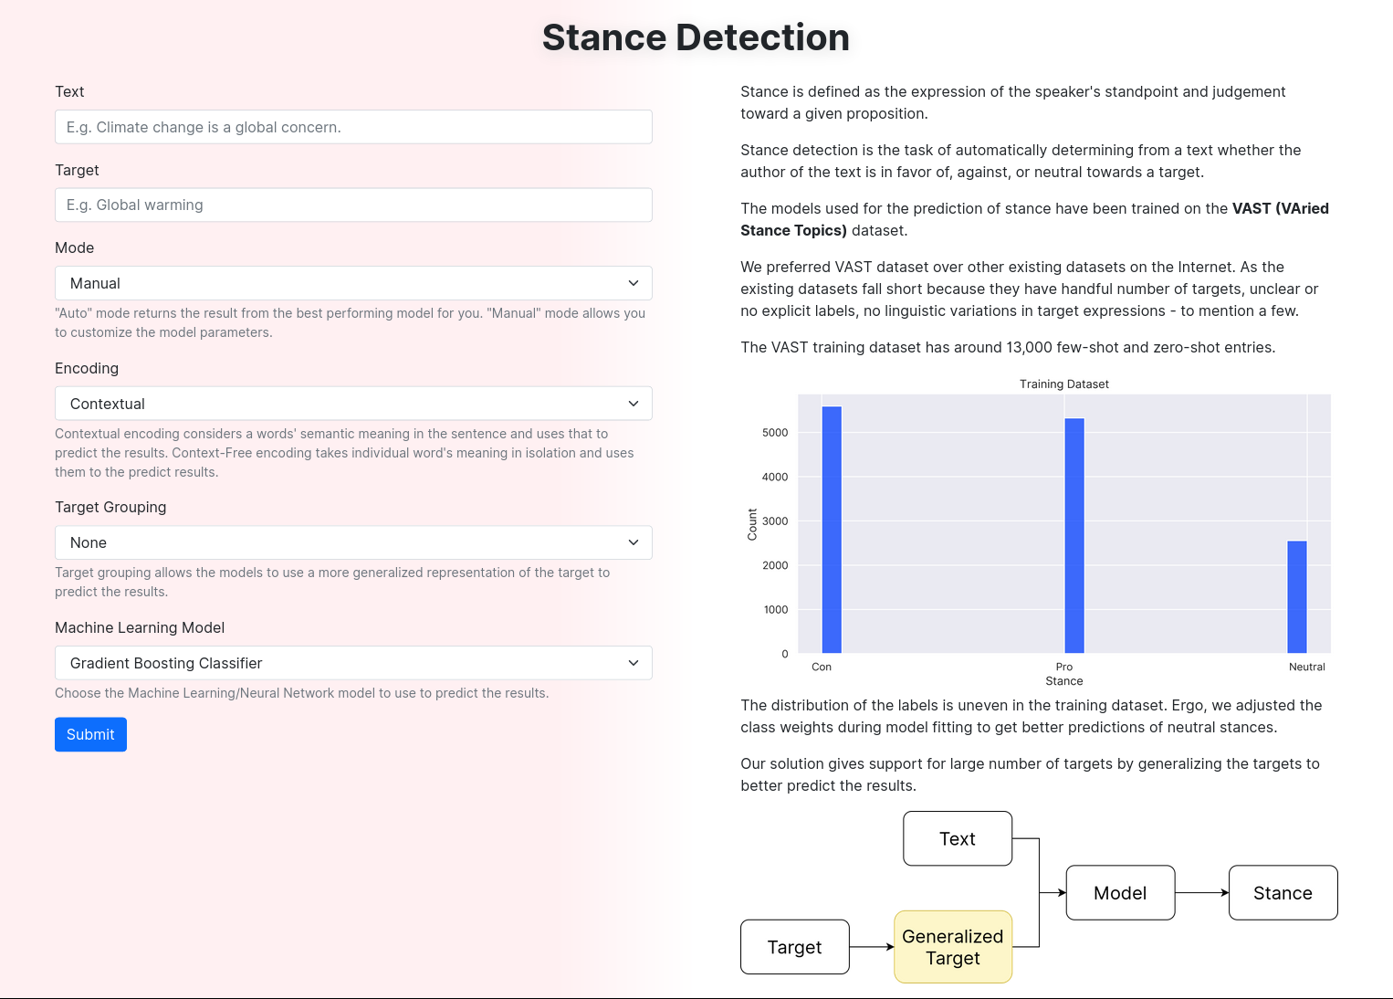
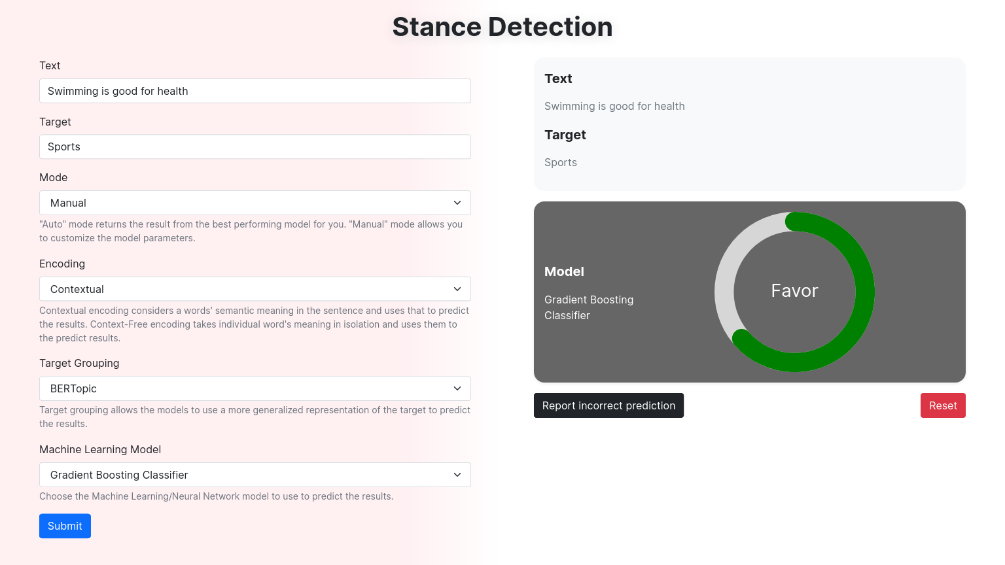
User Interface
Manual prediction
Main page

Slide 30
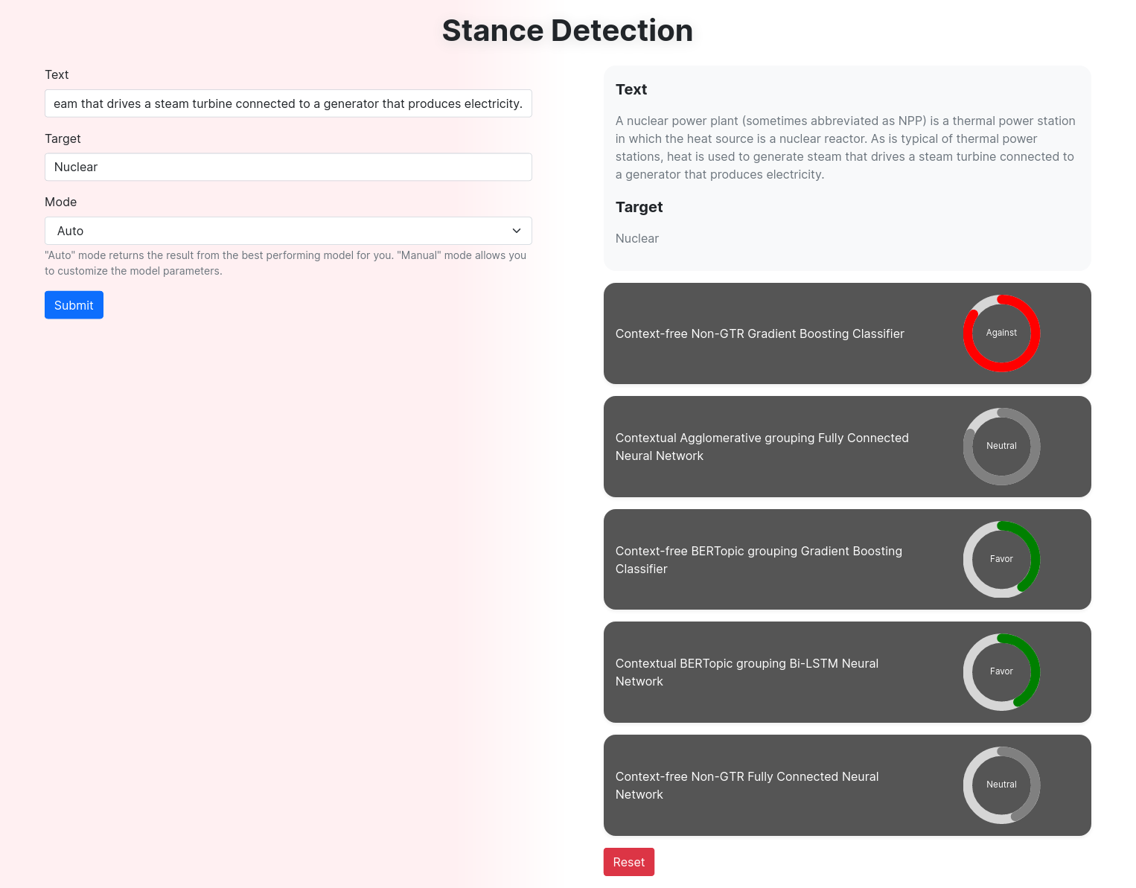
User Interface
Auto Prediction

Slide 31
Conclusion
We used VAST dataset for developing stance detection models. The development process includes choosing a embedding model (contextual or context-free), target generalizer (no generalization, agglomerative clustering, or BERTopic), and then feeding the processed inputs to the Scikit Learn or TensorFlow Neural Network classifiers.
Context-free no grouping gradient boosting classifier model was the best performing model overall. Comparison of contextual vs context-free embeddings showed that the overall performance of context-free sklearn models were better than contextual sklearn models; contextual neural network models showed slightly better results than context-free neural network models. Comparison of different generalization types showed that for context-free models, generalization performed better than no-generalization; for contextual models, the effects of generalization were not much prominent.
We checked the usefulness of the VAST dataset on another NLP task (Sentiment Analysis) where the developed model had an accuracy of 73%. We also developed a User Interface to get results from the 60 stance detection models.

Slide 32
Future Scope
The performances seen through our implementation can be further improved by -
Using better data than VAST dataset
Understanding the tradeoff between generalization and specialization of topic grouping.
Combination approach of Text and Target to feed to the models.
Furthermore, support for additional languages can be added.

Slide 33
References
Allaway, E., & McKeown, K. (2020). Zero-shot stance detection: A dataset and model using generalized topic representations. arXiv preprint arXiv:2010.03640.
Augenstein, I., Rocktäschel, T., Vlachos, A., & Bontcheva, K. (2016). Stance detection with bidirectional conditional encoding. arXiv preprint arXiv:1606.05464.
Devlin, J., Chang, M. W., Lee, K., & Toutanova, K. (2018). Bert: Pre-training of deep bidirectional transformers for language understanding. arXiv preprint arXiv:1810.04805.
Padnekar, S. M., Kumar, G. S., & Deepak, P. (2020, December). Bilstm-autoencoder architecture for stance prediction. In 2020 International Conference on Data Science and Engineering (ICDSE) (pp. 1-5). IEEE.

Slide 34
References
5. Global Social Media Stats - DataReportal – global digital insights. DataReportal. (n.d.). Retrieved April 20, 2022, from https://datareportal.com/social-media-users#:~:text=Kepios%20analysis%20shows%20that%20there,of%20the%20total%20global%20population .
6. Fujiwara, T., Müller, K., &amp; Schwarz, C. (2020, December 11). The effect of social media on elections: Evidence from the United States. SSRN. Retrieved April 20, 2022, from https://papers.ssrn.com/sol3/papers.cfm?abstract_id=3719998
Additional References

